Slide 1
EC 445 – Group Project III
Tittle: Face Mask Detection Model
A mask can make a difference!
Made By: Prishita Kapoor (17EC035)
Guided by: Prof. Jagrat Mehta

Slide 2
Why a face mask detection system?
The Face Mask Detection system is built on the stems of technology like Tensorflow , OpenCV, and Machine Learning. It can automatically authenticate the access of the person by a video/camera feed.
The live feed from the camera and the algorithm running in the background will automatically detect if the person is wearing the mask correctly and whether he should be given permission to enter the place.

Slide 3
INSTALLATION OF THE DEPENDANCIES:
TENSORFLOW/KERAS
IMUTILS
NUMPY
OPENCV
MATPLOTLIB
ARGPARSE
SCIPY

Slide 4
TENSORFLOW/KERAS:
TensorFlow is a framework of machine learning and deep learning.
It is a free and open-source library
TensorFlow can train and run the deep neural networks for image recognition, handwritten digit classification, recurrent neural network, natural language processing, video detection, and many more.

Slide 5
IMUTILS:
A series of functions to make basic image processing functions such as translation, rotation, resizing, skeletonization, displaying Matplotlib images, sorting contours, detecting edges, and much more easier with OpenCV and Python.

Slide 6
NUMPY:
NumPy is a Python package.
It stands for 'Numerical Python’.
It is a library consisting of multidimensional array objects and a collection of routines for processing of array.

Slide 7
OPENCV:
OpenCV is a cross-platform library using which we can develop real-time computer vision applications.
It mainly focuses on image processing, video capture and analysis including features like face detection and object detection

Slide 8
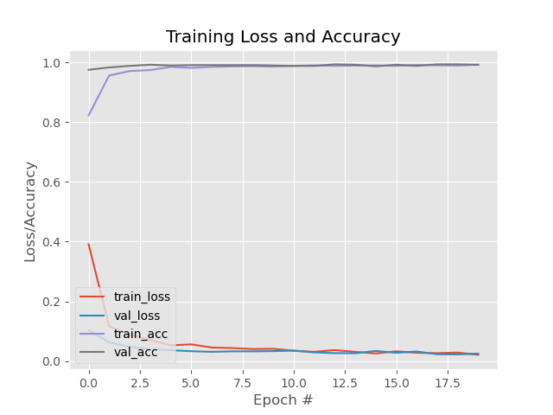
MATPLOTLIB:
Matplotlib is one of the most popular Python packages used for data visualization. It is a cross- platform library for making 2D plots from data in arrays. It provides an object- oriented API that helps in embedding plots in applications using Python GUI toolkits such as PyQt, WxPythonotTkinter.
It can be used in Python and IPython shells, Jupyter notebook and web application servers also.

Slide 9
FACE MASK DATASET
FLOWCHART:
TRAIN FACE MASK CLASSIFIER WITH TENSORFLOW
DETECT FACES IN IMAGE/VIDEO STREAM
EXTRACT EACH FACE ROI
APPLY FACE MASK CLASSIFER TO EACH FACE ROI TO DETERMINE “MASK” OR “NO MASK”
SHOWS RESULT

Slide 10
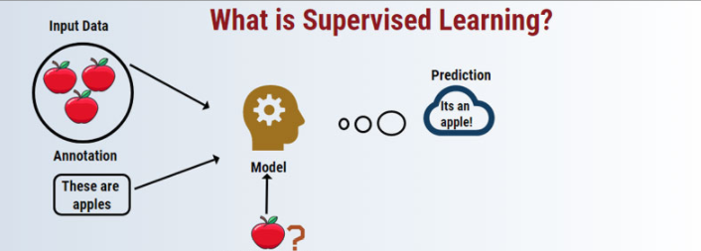
Supervised Learning:
In Supervised Learning, every training example has a corresponding label. The algorithm identifies the label and classifies the image accordingly. This model first identifies a Region of Interest (RoI) which in this case is a face.

Slide 11
the model works correctly to identify three classes:
1. With Mask: The person is wearing a mask and it is covering his nose and mouth. 2. Mask Worn Incorrect: The person is wearing a mask but it is not covering his nose or mouth. 3. Without Mask: The person is not wearing a mask.

Slide 12

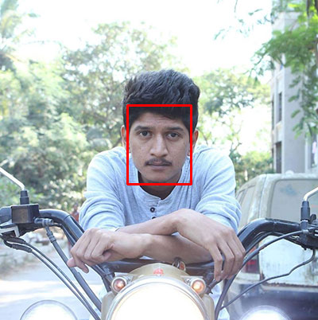
Training of model::
First with an image of a person not wearing a face mask.
t
We apply face detection to compute the bounding box location of the face in the image.

Slide 13

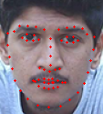
Once we know where in the image the face is, we can extract the face Region of Interest (ROI) with OpenCV and NumPy slicing.
We apply facial landmarks, allowing us to localize the eyes, nose, mouth, etc. we detects facial landmarks using dlib so that we know where to place a mask on the face.

Slide 14
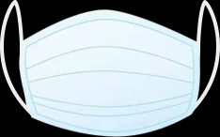

We need an image of a mask
The face mask is placed on the person’s face in the original frame. The mask has been applied with computer vision by way of OpenCV and dlib face landmarks.

Slide 15
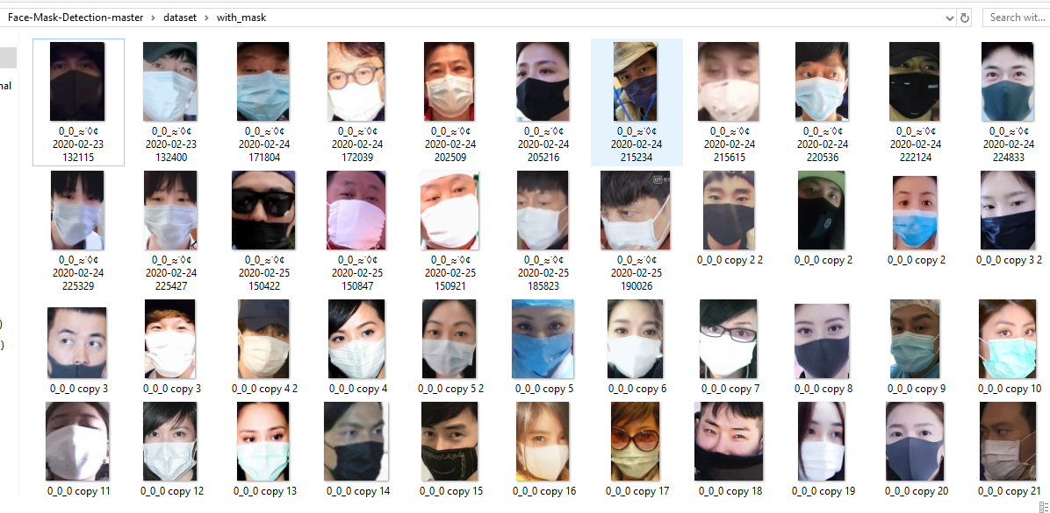
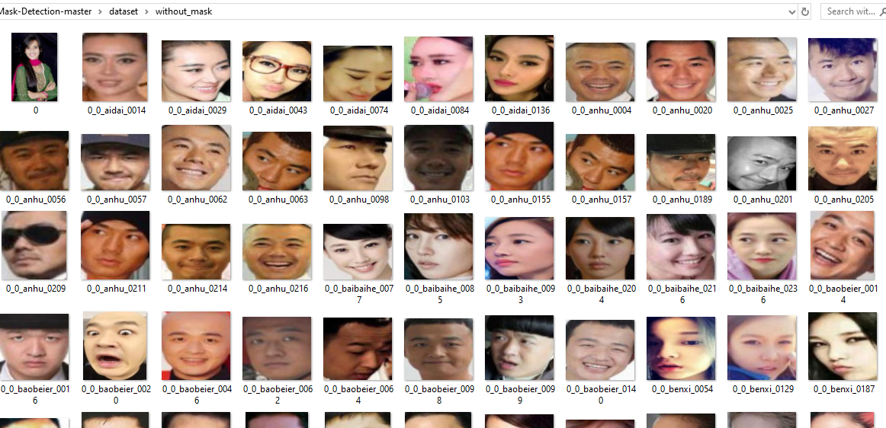
DATASET:
with_mask
without_mask

Slide 16
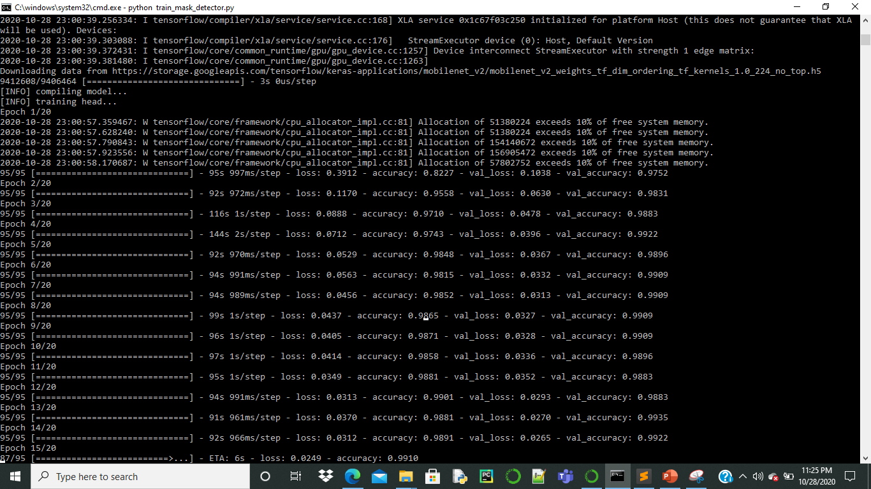
DATA PREPROCESSING:

Slide 17
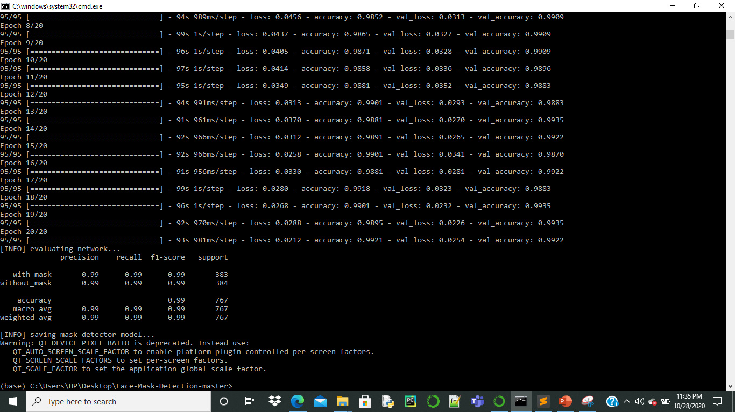

Slide 18
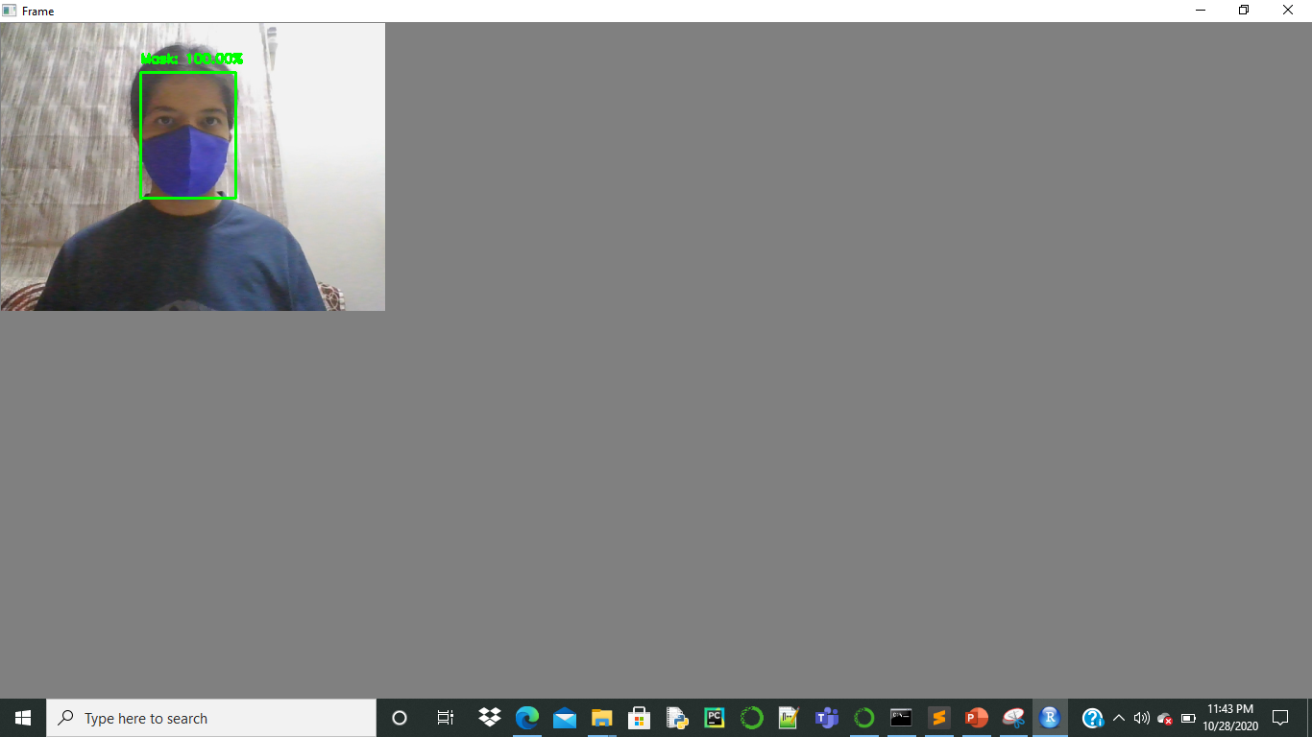
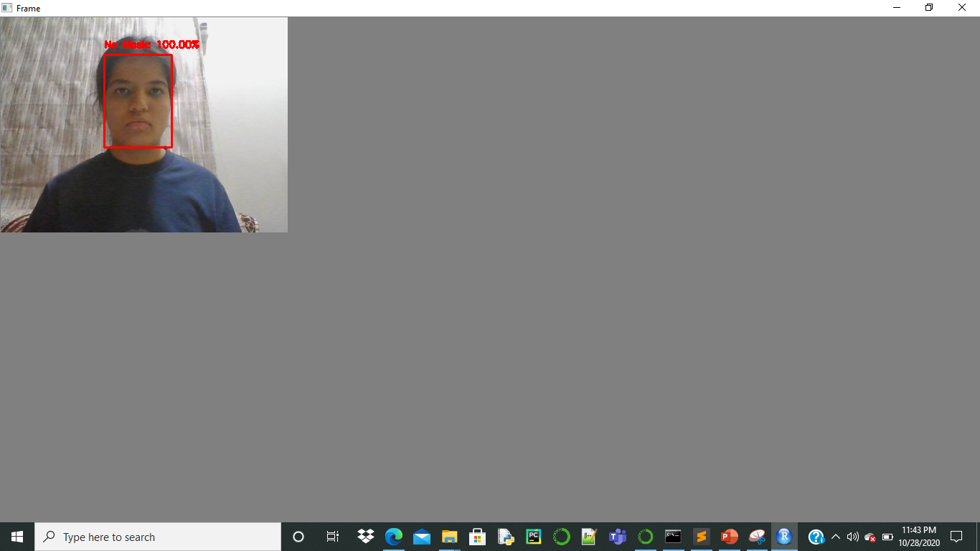
Output:

Slide 19
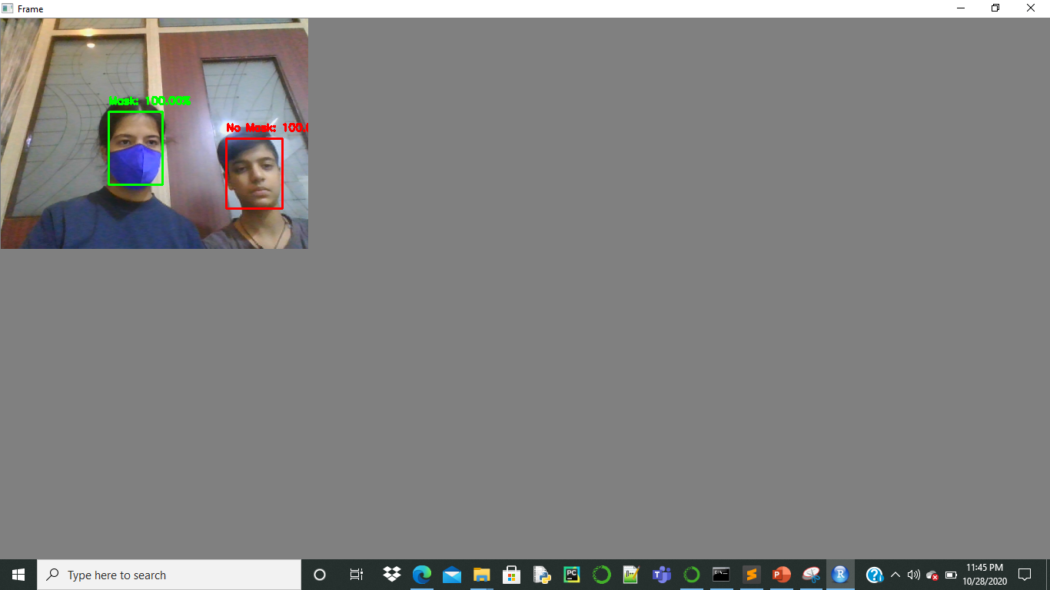
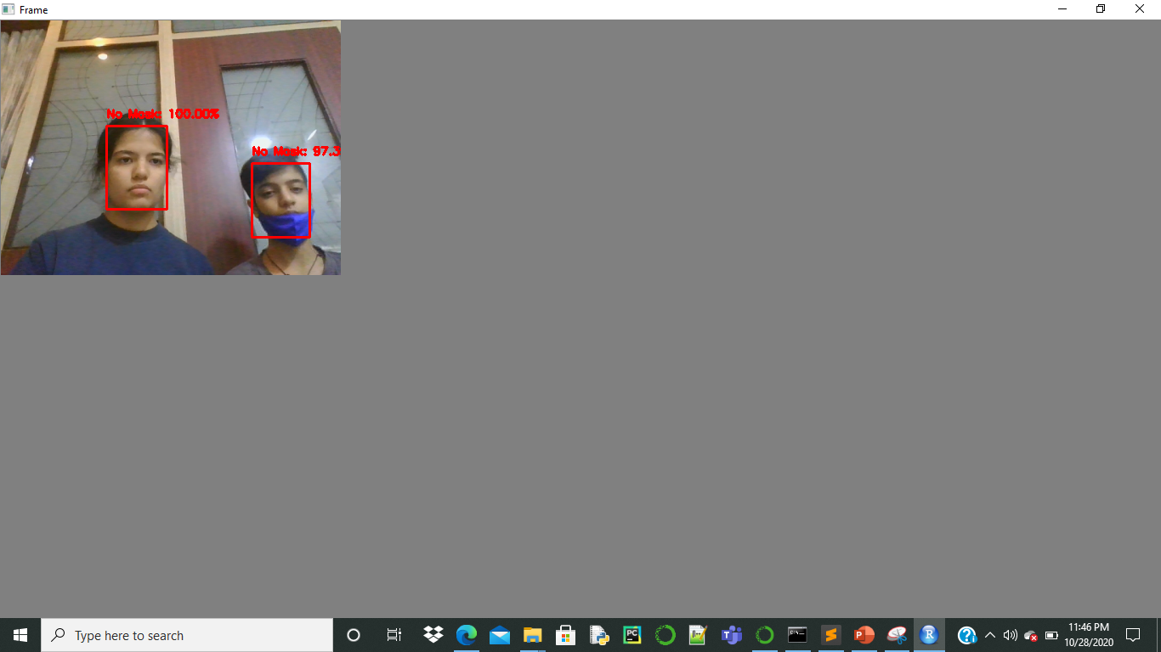

Slide 20
APPLICATION:
It can be deployed in office spaces, shops, restaurants, airports, and even homes.

Slide 21


